Slide 1
Resource Degradation and Rural Livelihood

Slide 2
This is what we will discuss on
The degradation of resources by the industries causes a great deal of difficulties for the rural livelihood.
We shall demonstrate the various ways in which resources belonging to the rural people are being degraded, and what kind of difficulty it lands them onto.

Slide 3
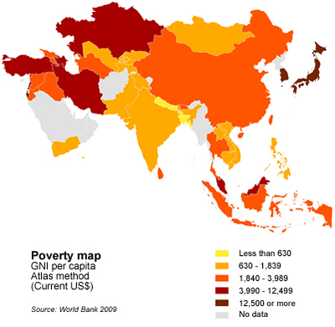

Slide 4
As new industries come up, land owned by the rural people is snatched away by the fat industry managers.

Slide 5
Chop down the trees, blow out the mountains, to get the metals inside, use up all the water, wipe out the animals.
We are running out of resources.
In the past three decades alone one-thirds of the planets natural resources been consumed.
In the us they have less than 4% of forests left.

Slide 6
40% of us waterways have become undrinkable.
80% of planet’s original forestry is gone. 2000 trees a minute. 7 footballs fields.
According to industries rural peopl don’t even own the places & resources even if they have been living there for generations.

Slide 7
If you don’t own or buy then you don’t have value.
Rural people are thrown out of their area and the only way out for them is to work as workers in industrris.
They expose themseleves to reproductive toxis, etc. none care of their health,

Slide 8
They live in slums. Have no other option . This is what happens in big citiesof india as well (ex-mumbai)(200,000 people a day globally)
Constant supply of workers avaiable for industries. No matter how toxic that work may be.
By products ; pollution. Kids in the congo pay with their future. Made to work in factories.

